Slide 1
string manipulation Instructions

Slide 2
String-Introduction
String is a series of bytes or a series of words in sequential memory locations.
Index registers
- SI (Data segment)
- DI (Extra segment)
Direction Flag (DF)
- DF=0 ->increment
- DF=1 ->decrement
Counter CX

Slide 3
CLD: Clear Direction Flag
Clear direction flag to 0
DF=0, SI and DI will automatically be incremented when one of the string instructions, such as MOVS, CMPS, or SCAS, Executes
Syntax:
CLD

Slide 4
STD: Set Direction Flag
set direction flag to 1
DF=1, SI and DI will automatically be decremented when one of the string instructions, such as MOVS, CMPS, or SCAS, Executes
Syntax:
STD

Slide 5

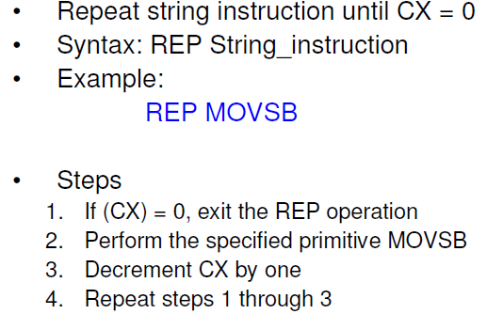

Slide 6
REP….
REPE/REPZ: Repeat if Equal/Zero
Termination condition: CX=0 or ZF=1
REPNE/REPNZ: Repeat if not Equal/Zero
Termination condition: CX=0 or ZF=0

Slide 7
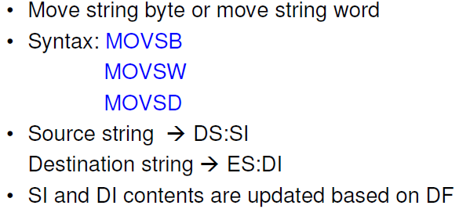
MOVS/MOVSB/MOVSW

Slide 8
Mov string byte or word
data segment
tr db "tis time for a new home$"
new db 23 dup(0)
data ends
code segment
assume cs:code, ds:data,es:data
start: mov ax,data
mov ds,ax
mov es,ax
lea si,str
lea di,new
mov cx,23
cld
rep movsb
mov ah,4ch
int 21h
code ends
end start

Slide 9
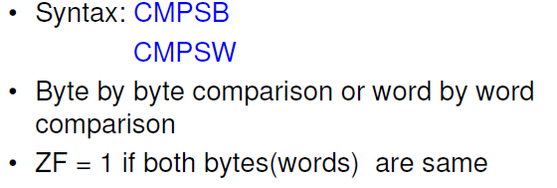
Example

Slide 10
String comparison
data segment
str db "welcome to MIT$"
len equ ($-str)
input db "welcome to MIT$"
aa db ?
data ends
code segment
assume cs:code, ds:data, es:data
start: mov ax,data
mov ds,ax
mov es,ax
lea si,str
lea di,input
mov cx,len
cld
repe cmpsb
jne do
mov al,01
mov aa,al
do:mov aa,02
mov ah,4ch
int 21h
code ends
end start

Slide 11

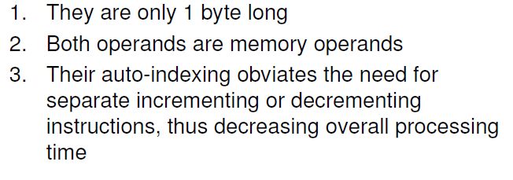

Slide 12
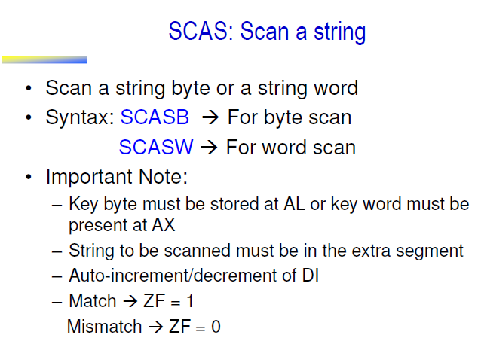

Slide 13
Length of the string
data segment
str db "manipal$"
len dw ?
data ends
code segment
assume cs:code, ds:data, es:data
start: mov ax,data
mov ds,ax
mov es,ax
mov al,'$'
lea di,str
mov cx,00h
cld
go: inc cx
scasb
jnz go
dec cx
mov len,cx
mov ah,4ch
int 21h
code ends
end start

Slide 14
EQU-Equate
Used to give a name to some value or symbol
Each time the assembler finds the given name in the program , it will replace the name with the value or symbol you equated with the name.
Example:
Correction_factor equ 03h
Add al,correction_factor ; add al,03h

Slide 15
Length of the string
data segment
str db "manipal$"
len equ ($-str)
strlen dw ?
data ends
code segment
assume cs:code, ds:data, es:data
start: mov ax,data
mov ds,ax
mov es,ax
mov cx,len
mov strlen,cx
mov ah,4ch
int 21h
code ends
end start

Slide 16
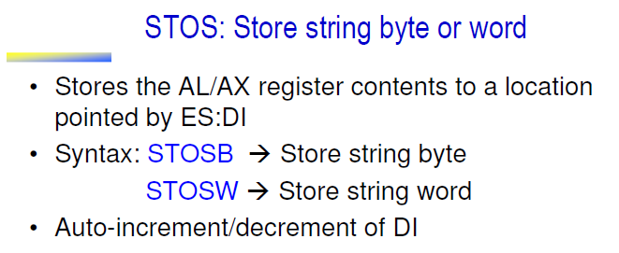

Slide 17
